Slide 1

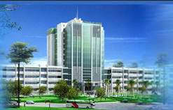
HCMC University of Technology and Education
Faculty of Electrical & Electronics Engineering
Lecture:
IMAGE PROCESSING
Chapter 4:
Image Filtering
1
Notes:
1

Slide 2
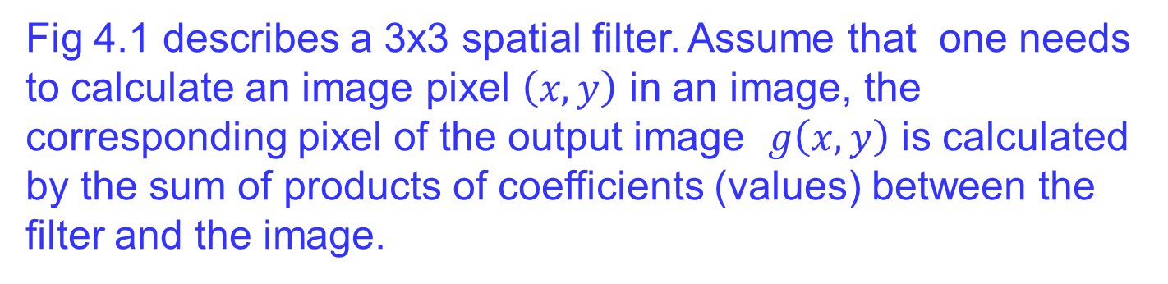
Image Filtering
IMAGE FILTERING IN THE SPATIAL DOMAIN
A spatial filter means that a typical pixel in image is calculated based on neighborhood pixels. The filter is moved to all image pixels to create the output image.
Fig 4.1 describes a 3x3 spatial filter. Assume that one needs to calculate an image pixel $\left(x,y\right)$ in an image, the corresponding pixel of the output image $g\left(x,y\right)$ is calculated by the sum of products of coefficients (values) between the filter and the image.

Slide 3
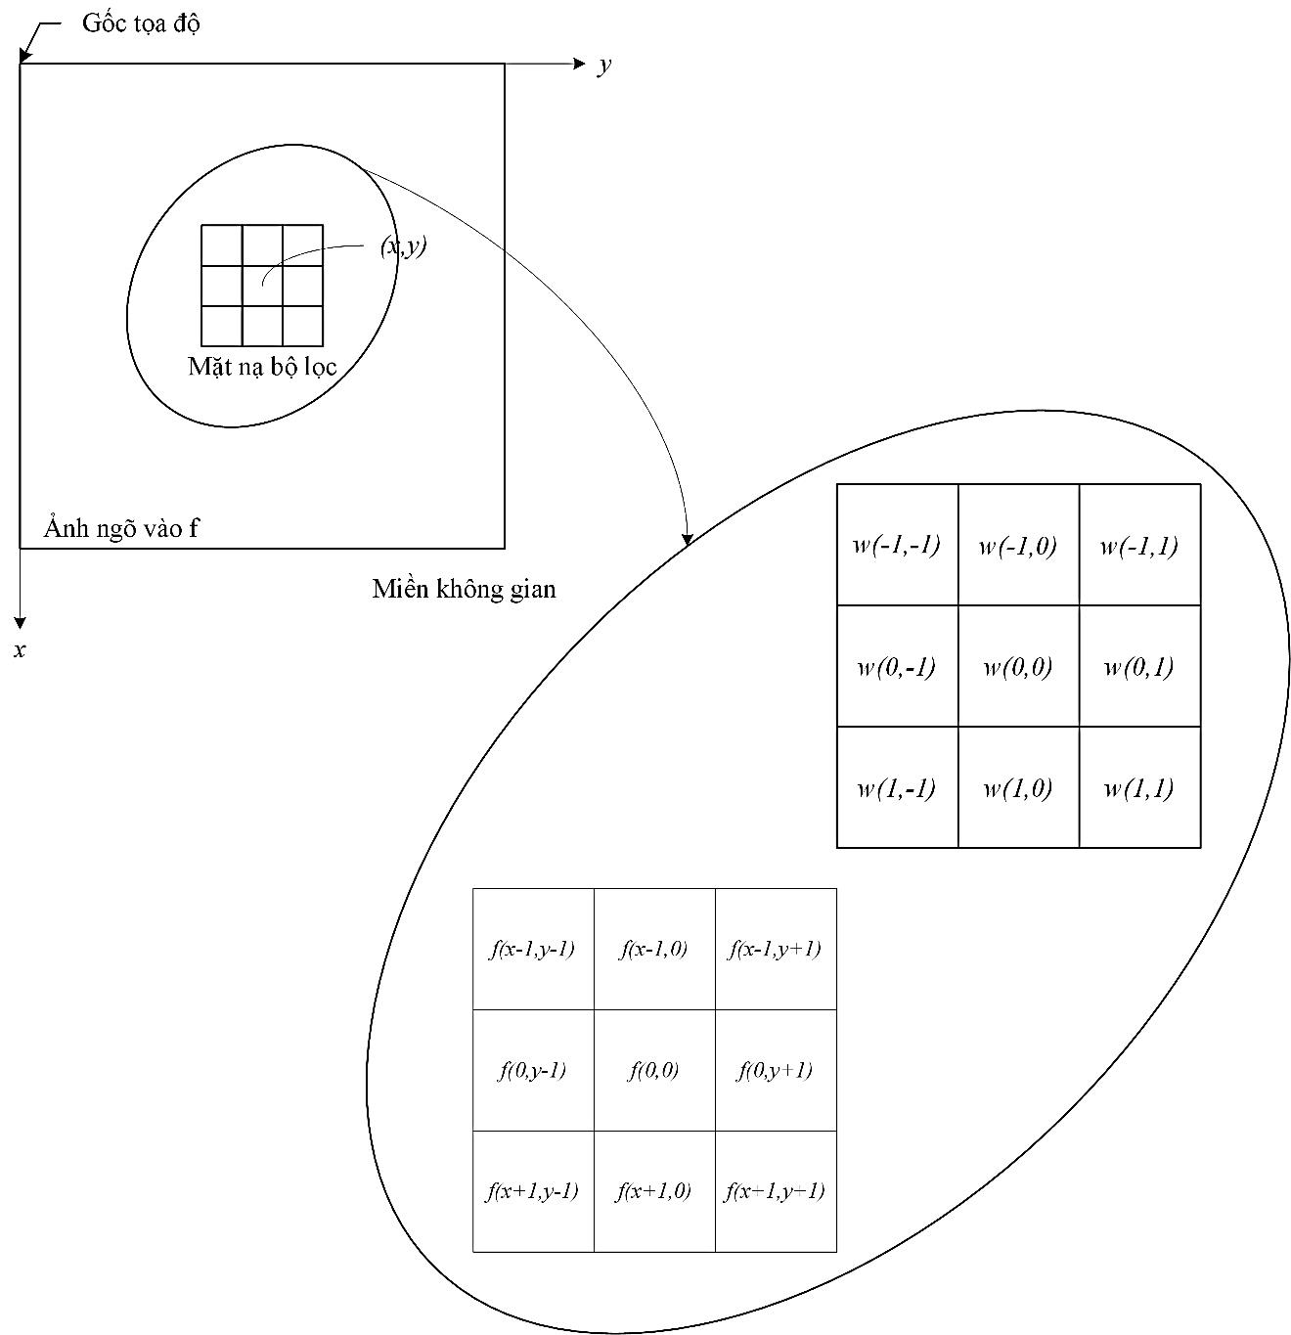
Image Filtering
Fig. 4.1. Diagram of the 3x3 spatial filter and on image.

Slide 4
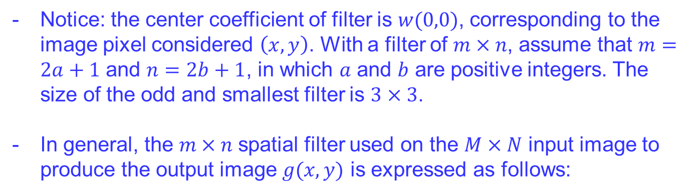
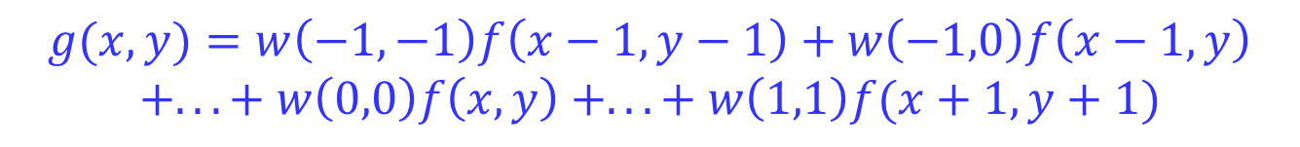
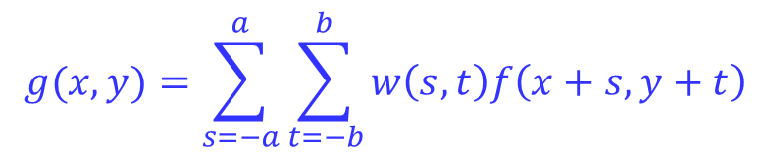
Image Filtering
IMAGE FILTERING IN THE SPATIAL DOMAIN
Notice: the center coefficient of filter is $w(0,0)$, corresponding to the image pixel considered $\left(x,y\right)$. With a filter of $m×n$, assume that $m=2a+1$ and $n=2b+1$, in which $a$ and $b$ are positive integers. The size of the odd and smallest filter is $3×3$.
In general, the $m×n$spatial filter used on the $M×N$ input image to produce the output image $g(x,y)$ is expressed as follows:
$$g(x,y)=\sum_{s=−a}^{a}{\sum_{t=−b}^{b}{w\left(s,t\right)f\left(x+s,y+t\right)}}$$
$$g(x,y)=w\left(−1,−1\right)f\left(x−1,y−1\right)+w\left(−1,0\right)f\left(x−1,y\right)$$
$$+... + w\left(0,0\right)f\left(x,y\right) +... + w\left(1,1\right)f(x+1,y+1)$$

Slide 5
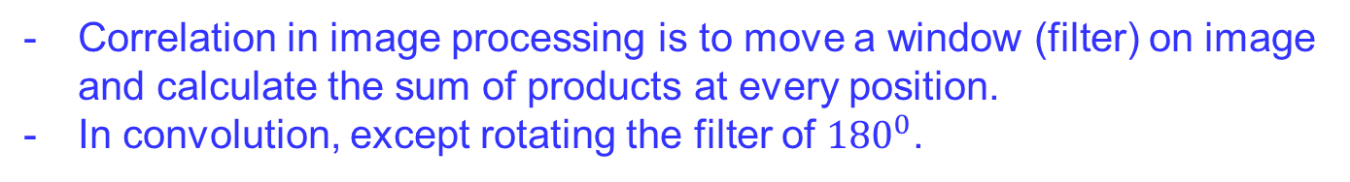
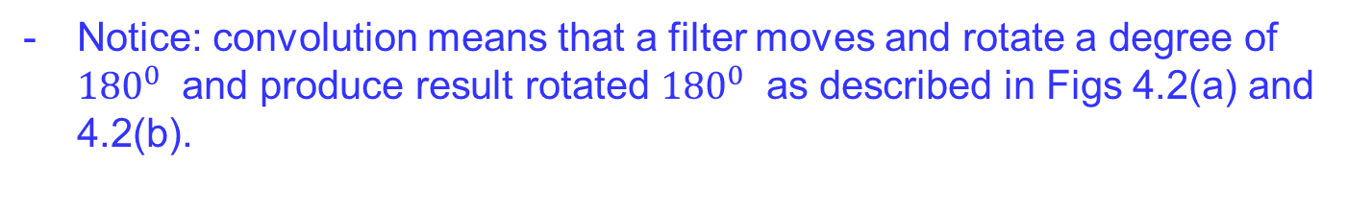
Image Filtering
IMAGE FILTERING IN THE SPATIAL DOMAIN
Correlation and convolution in spatial domain
Correlation in image processing is to move a window (filter) on image and calculate the sum of products at every position.
In convolution, except rotating the filter of ${180}^{0}$.
Notice: convolution means that a filter moves and rotate a degree of ${180}^{0}$ and produce result rotated ${180}^{0}$ as described in Figs 4.2(a) and 4.2(b).
Fig. 4.2. is description of correlation and convolution methods between the 1D signal and the unit impulse. Notice of transposing.

Slide 6
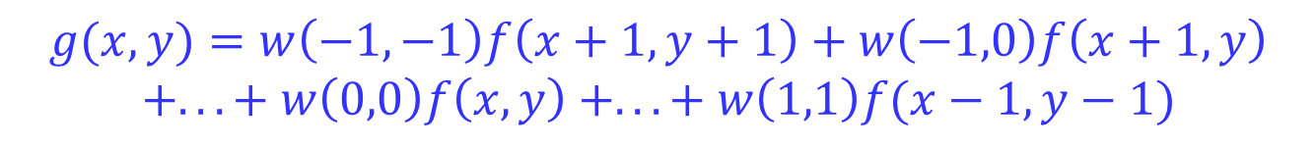
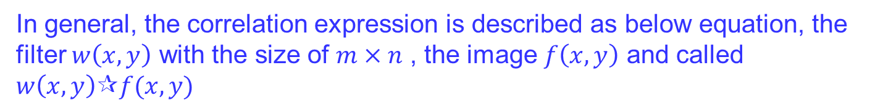
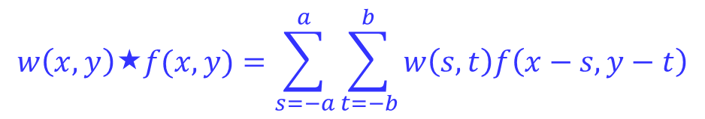
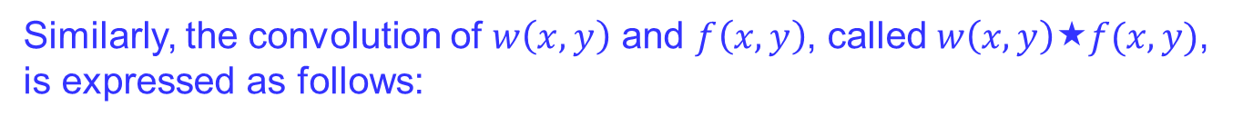
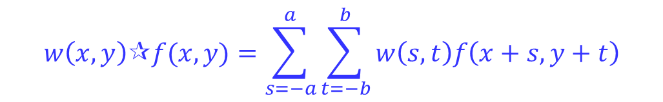
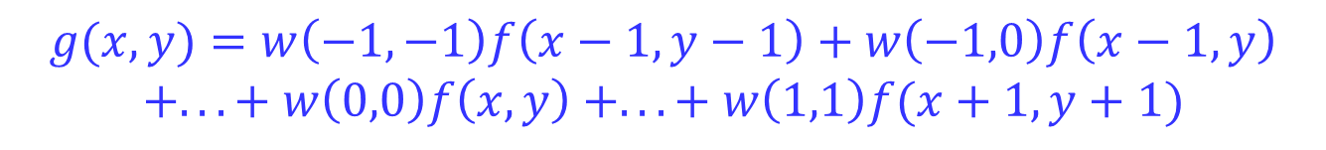
Image Filtering
In general, the correlation expression is described as below equation, the filter $w\left(x,y\right)$ with the size of $m×n$ , the image $f\left(x,y\right)$ and called $w\left(x,y\right)∂f(x,y)$
$$w\left(x,y\right)∂f(x,y)=\sum_{s=−a}^{a}{\sum_{t=−b}^{b}{w\left(s,t\right)f\left(x+s,y+t\right)}}$$
$$g(x,y)=w\left(−1,−1\right)f\left(x−1,y−1\right)+w\left(−1,0\right)f\left(x−1,y\right)$$
$$+... + w\left(0,0\right)f\left(x,y\right) +... + w\left(1,1\right)f(x+1,y+1)$$
Similarly, the convolution of $w\left(x,y\right)$ and $f\left(x,y\right)$, called $w\left(x,y\right)↔f(x,y)$, is expressed as follows:
$$w\left(x,y\right)↔f(x,y)=\sum_{s=−a}^{a}{\sum_{t=−b}^{b}{w\left(s,t\right)f\left(x−s,y−t\right)}}$$
$$g(x,y)=w\left(−1,−1\right)f\left(x+1,y+1\right)+w\left(−1,0\right)f\left(x+1,y\right)$$
$$+... + w\left(0,0\right)f\left(x,y\right) +... + w\left(1,1\right)f(x−1,y−1)$$
The symbol minus means that the image $f$ is rotated 180 degrees.

Slide 7
Image Filtering
Ex: Using the correlation and convolution methods to calculate the output image at the position g(2,1).
y
y: 0 to 4
1 | 1 | 1 | 2 | 2
1 | 1 | 1 | 2 | 2
1 | 1 | 1 | 2 | 2
2 | 2 | 2 | 2 | 2
2 | 2 | 2 | 2 | 2
 | 12
t: -1 to -1
x: 0 to 4
1 | 1 | 1
1 | 1 | 1
1 | 1 | 1
x
s: -1 to 1
Input image
Mask (filter)
Output image
g(x,y)=g(2,1)
7
Notes:
7

Slide 8
Image Filtering
Median Filters
Median filters are often used to reduce the noise without eliminating the edges and other high frequency contents.
The operation of the filters to find each pixel value in the processed image has 3 steps:
* Step 1: All pixels in the neighborhood of the pixel in the original image (identified by the mask) are inserted in a list.
* Step 2: This list is sorted in ascending (or descending) order.
* Step 3: The median of the sorted list (i.e., the pixel in middle of the list) is chosen as the pixel value for the processed image.
Notes:
8

Slide 9
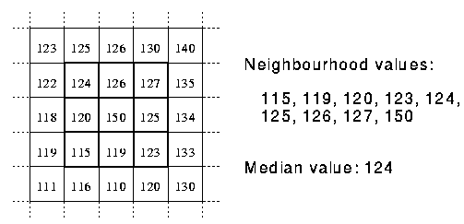
Image Filtering
A median filter creates pixel values of the filtered image based on the storing of the gray level of the pixels in the mask around the central pixel in the original image.
Example 4.3: Fig. 4.3 illustrates the performance of a 3x3 median filter on a sub-image. According to the sorted list, the response of the filter is 12.
12 | 10 | 8
45 | 23 | 10
64 | 12 | 10
12
Fig. 4.3: Mask of median filter
8, 10, 10, 10, 12, 12, 23, 45, 64
9
Notes:
9

Slide 10
Image Filtering
A mean filter is the average of the pixel values.
Example: Fig. below illustrates the performance of a 3x3 mean filter on a sub-image. According to the sorted list, the response of the filter is 12.
12 | 10 | 8
45 | 23 | 10
64 | 12 | 10
(8+10+10+10+12+12+23+45+64)/9
=194/9~21,55=22
Thus, the mean value is 22
22
Fig. : Mask of mean filter
10
Notes:
10

Slide 11
Image Filtering
The main advantage of median filters is that they reduce the random noise without eliminating the useful high frequency components such edges. This means that while a median filter provides smoothing effects similar to those of a linear lowpass filter, it avoids the blurring effects that are associated with linear smoothing filters.
Median filters have certain disadvantages, for example
* the number of noisy pixels is more than half of the total pixels
* the additive noise is Gaussian in nature.
Notes:
11

Slide 12
Image Filtering
Example 4.4: Students are required to write a program to check this median filter using Matlab (medfilt2).
a
b
Fig. 4.4: (a)- Noisy image; (b)- Median filtered image.
Notes:
12

Slide 13
Image Filtering
Example 4.5: Students are required to write a program to check this median filter using Matlab.
Fig. 4.5: (a)- No-noisy image, (b)- Noisy image, (c)- image after lowpass filter, and (d)- image after median filter.
a
b
c
d
Notes:
13

Slide 14
Image Filtering
IMAGE FILTERING IN THE SPATIAL DOMAIN
Some functions in MATLAB
- Ones: matrix 1.
- imfilter(f,h,'Boundary Options','OutputSize','Correlation and Convolution Options')
'Boundary Options' : allow to select a boundary of the output image
'Output Size‘: select the output size with 'Correlation and Convolution Options'.
More functions in Table. 4.1 of Image Processing book

Slide 15
Image Filtering
Some filters expressed by mathematic methods:
* Gaussian
or
* Laplacian
or

Slide 16
Image Filtering
* Log (Laplacian of Gaussian)
* Prewitt
* Sobel

Slide 17
Image Filtering
Ex 4.6: Express image filtering using filters in toolbox of MATLAB
clear all;
f=imread('cameraman.bmp');
ha=fspecial('average');
ga=imfilter(f,ha,'replicate');
hd=fspecial('disk');
gd=imfilter(f,hd,'replicate');
hg=fspecial('gaussian');
gg=imfilter(f,hg,'replicate');
hlap=fspecial('laplacian');
glap=imfilter(f,hlap,'replicate');
hlog=fspecial('log');
glog=imfilter(f,hlog,'replicate');
hm=fspecial('motion');
gm=imfilter(f,hm,'replicate');
hp=fspecial('prewitt');
gp=imfilter(f,hp,'replicate');
hs=fspecial('sobel');
gs=imfilter(f,hs,'replicate');

Slide 18
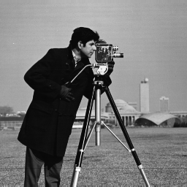
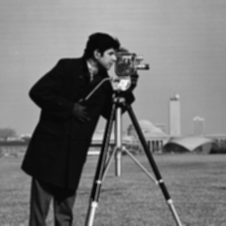


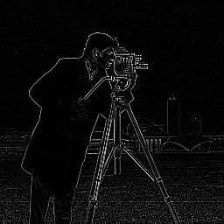
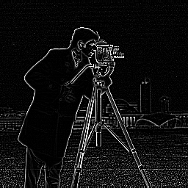
Image Filtering
(a)
(b)
(c)
(d)
(e)
(f)

Slide 19

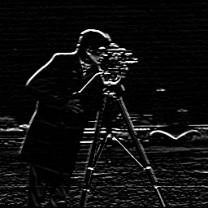
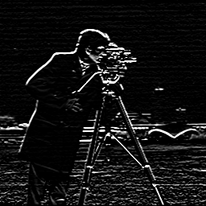
Image Filtering
(g)
(h)
(i)
Fig 4.6. Express images with different filters
(a) Original image; (b) Average; (c) Disk; (d) Gaussian; (e) Laplacian; (f) Log; (g) Motion; (h) Prewitt; (i) Sobel

Slide 20
Image Filtering
The End
20
Notes:
20

